Slide 1
PORs: Proofs of Retrievability for Large Files
Ari Juels, Burton S. Kaliski Jr
14th ACM conference on Computer and communications security,2007
Cited:793
Presenter:張哲豪
Date:2014/11/24
Notes:
First define POR
American

Slide 2
Outline
Introduction
Definitions
Sentinel-Based POR scheme
Conclusions

Slide 3
First approach
Notes:
Keyed-hash protocol
An encoding algorithm transforms a raw file F into an encoded file ˜ F to be stored with the prover / archive
Verifier stores a hash value r = h_{k}(F)

Slide 4
Drawback of keyed-hash
High resource cost
Verifier store a number of hash values
Prover process the entire file F
For Large F, can be highly burdensome
Prover read the entire file for every proof
Every file are be tested frequently

Slide 5
Proposed approach(sentinel)
To protect against corruption by the prover of a small portion of F
E(F)
Notes:
If the prover has modified or deleted a substantial portion
of F, then with high probability it will also have suppressed
a number of sentinels

Slide 6

Drawback of sentinel
Preprocessing/encoding of F required prior to storage with the prover
The sentinels may constitute a small fraction of the encoded $\tilde{F}$

Slide 7
Outline
Introduction
Definitions
Sentinel-Based POR scheme
Conclusions

Slide 8
Characteristics
No common string x
P have knowledge of some file F
V possesses secret keys for verifying
No natural relation R
Let y=F, if we regard x as the input available to V, there is no relation R(x,y)
x may be perfectly independent of F
Split verifier/extractor knowledge
K may take a secret input unknown to either P or V
Notes:
isolate the ability to verify from the ability to extract

Slide 9
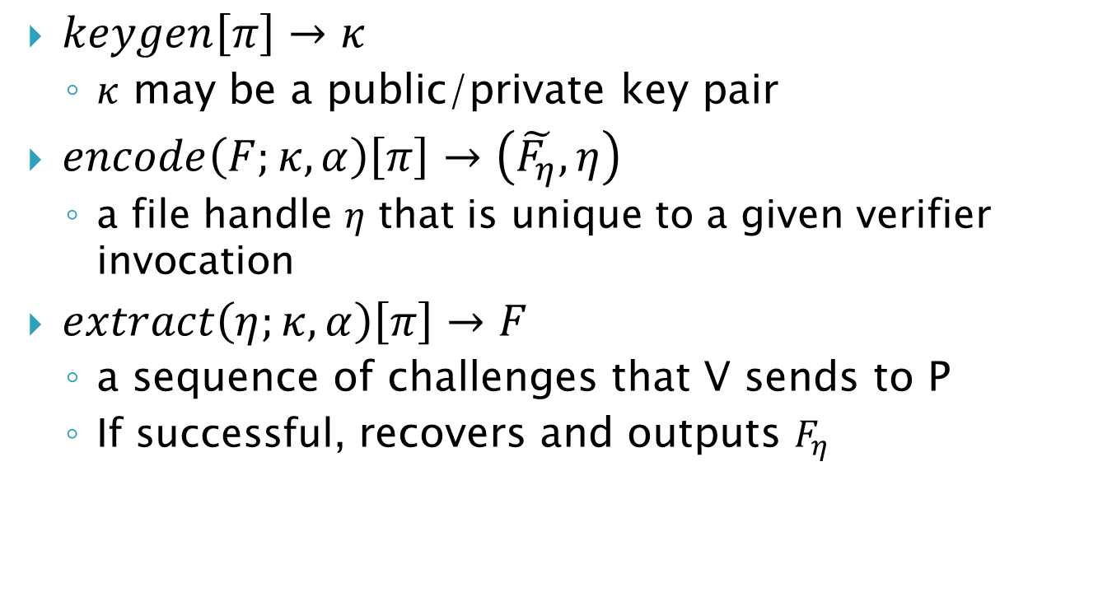
POR system
$keygen\left[π\right]→κ$
$κ$ may be a public/private key pair
$encode\left(F;κ,α\right)\left[π\right]→\left(\tilde{F_{η}},η\right)$
a file handle $η$ that is unique to a given verifier invocation
$extract\left(η;κ,α\right)\left[π\right]→F$
a sequence of challenges that V sends to P
If successful, recovers and outputs $F_{η}$
Notes:
$π$ denote the full collection of system parameters

Slide 10
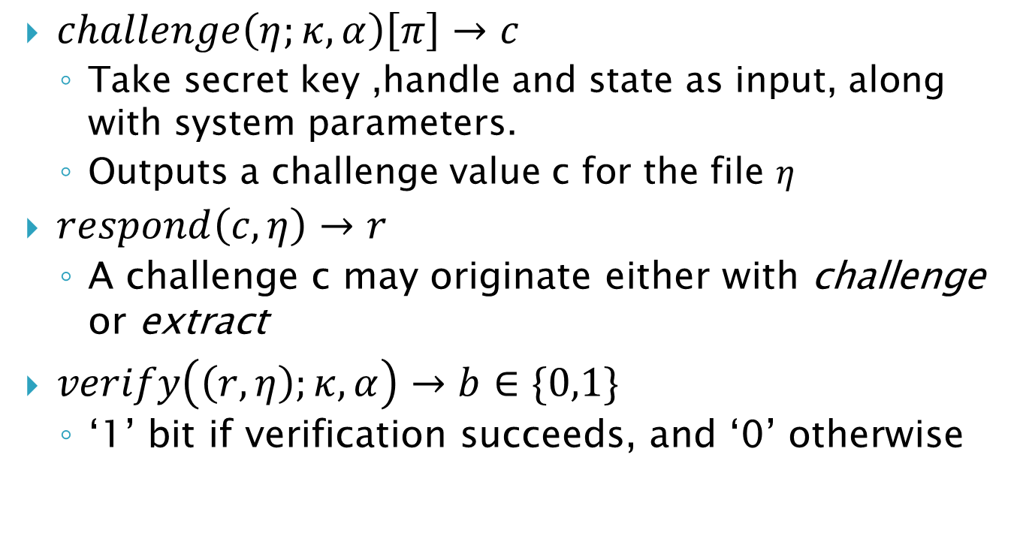
POR system
$challenge\left(η;κ,α\right)\left[π\right]→c$
Take secret key ,handle and state as input, along with system parameters.
Outputs a challenge value c for the file $η$
$respond\left(c,η\right)→r$
A challenge c may originate either with challenge or extract
$verify\left(\left(r,η\right);κ,α\right)→b∈\{0,1\}$
‘1’ bit if verification succeeds, and ‘0’ otherwise

Slide 11
POR definition

Slide 12
Outline
Introduction
Definitions
Sentinel-Based POR scheme
Conclusions

Slide 13
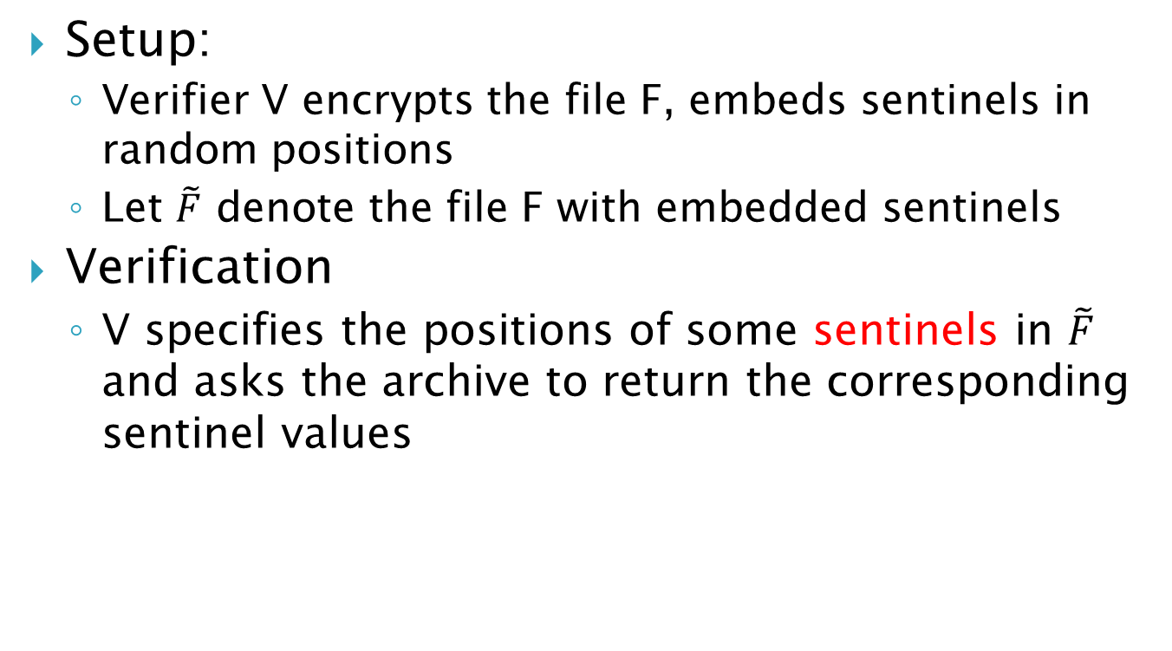
Sentinel-based POR
Setup:
Verifier V encrypts the file F, embeds sentinels in random positions
Let $\tilde{F}$ denote the file F with embedded sentinels
Verification
V specifies the positions of some sentinels in $\tilde{F}$ and asks the archive to return the corresponding sentinel values

Slide 14
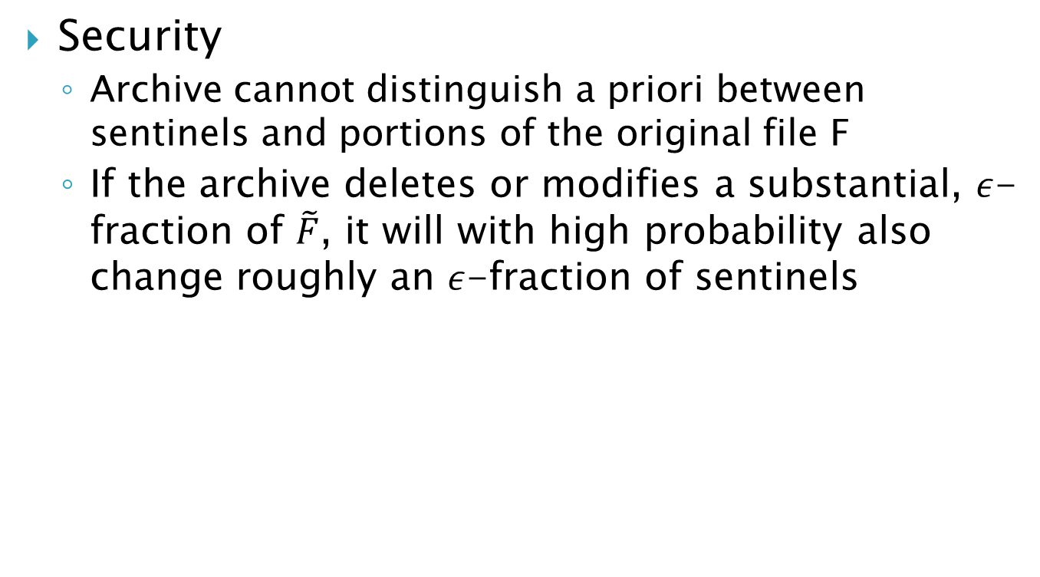
Sentinel-based POR
Security
Archive cannot distinguish a priori between sentinels and portions of the original file F
If the archive deletes or modifies a substantial, $ε$-fraction of $\tilde{F}$, it will with high probability also change roughly an $ε$-fraction of sentinels

Slide 15
Sentinel scheme details
Error correction
carve file F into k-block “chunks”，each chunk apply an (n,k,d)-error correcting code
Encryption
Symmetric-key cipher E to F’. Require the ability to decrypt data blocks in isolation, as our aim is to recover F even when the archive deletes or corrupts blocks

Slide 16
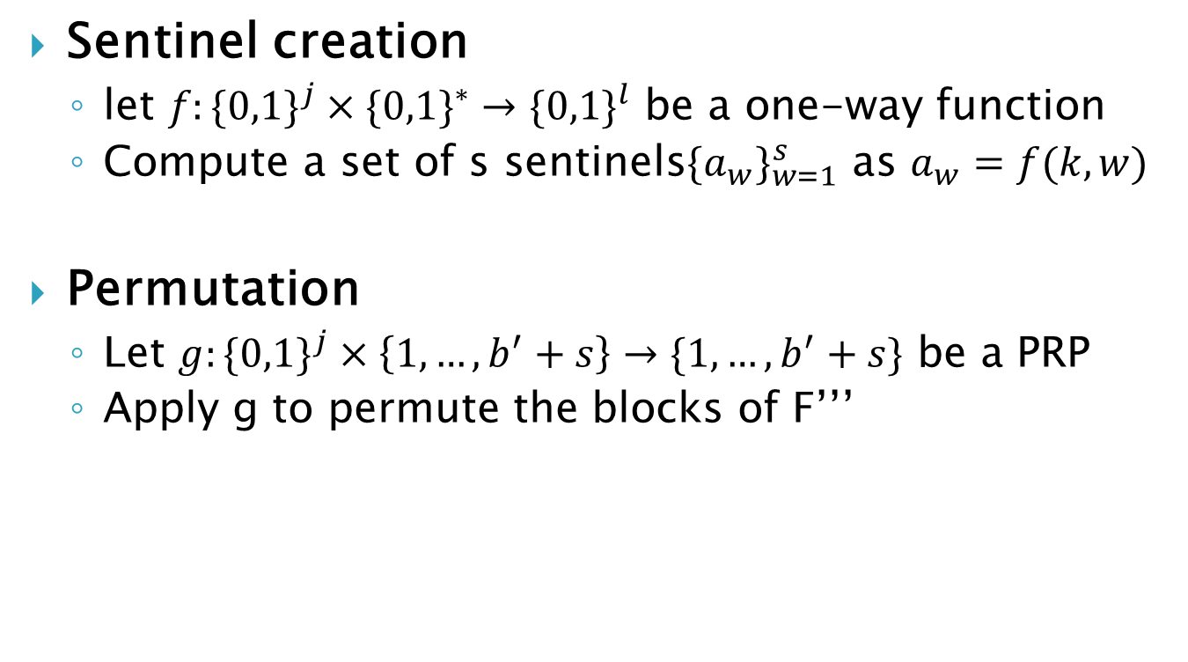
Sentinel scheme details
Sentinel creation
let $f:\{0,1\}^{j}×\{0,1\}^{∗}→\{0,1\}^{l}$ be a one-way function
Compute a set of s sentinels$\{a_{w}\}_{w=1}^{s}$ as $a_{w}=f(k,w)$
Permutation
Let $g:\{0,1\}^{j}×\left\{1,…,b^{′}+s\right\}→\{1,…,b^{′}+s\}$ be a PRP
Apply g to permute the blocks of F’’’

Slide 17
Conclusions
Main POR protocol is designed to protect a static archived file F.
Archive could change the modified block with impunity ,having learned that they are not sentinels
How to construct a POR that can accommodate partial file updates, perhaps through the dynamic addition of sentinels or MACs

